Slide 1

PRECISE HOSPITAL
Co-founders:
Gayatri Kota
Sanjana Reddy Byreddy
Srinivas Reddy Kothalachinta
Saveen Reddy Chapala
Sainath Reddy Chennu
DivyaGnana Preetham yaddalapuri

Slide 2
VALUE PROPOSITION
“BEST ROUTE FOR BETTER TREATMENT”

Slide 3

TARGET MARKET
911 Emergency services
Government

Slide 4
Key Features AND CAPABILITIES
En-route based on beds availability and specialists' availability
Notification to Hospital
Provide information to Government regarding the hospital resources
Helps patients notify the hospitals/ ambulance drivers.

Slide 5
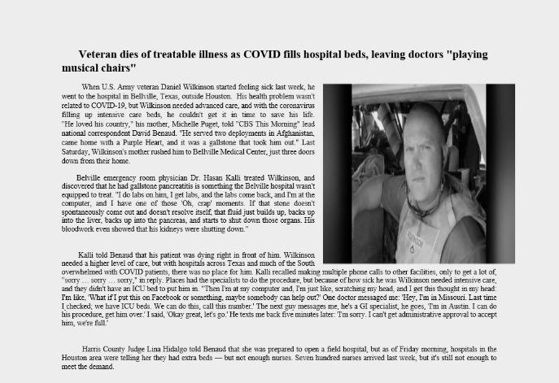
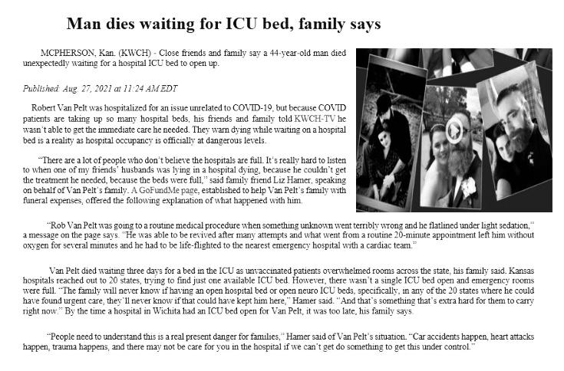
REAL LIFE SCENARIOS
Veteran dies of treatable illness as COVID fills hospital beds , leaving doctors “playing musical chairs.”
Man dies waiting for ICU bed, family says.

Slide 6
JUSTIFICATIONS
What is lacking in the above 2 scenarios?
With PH the gap can be bridged.
The application’s capabilities ensure no anomalies.
No life can be lost due to lack of correct information at prime time.

Slide 7
CONCLUSION
Key features are finalized.
Came up with an exact idea what could justify the problem that we discussed.
GPS based routing application makes ambulance drivers reach the appropriate hospital.
User friendly interface makes patients report the accidents/health emergency easily.
Helps save lives.
In future, we can develop this application and include many features like giving access to common people about the beds availability in nearest hospital, hospital resources availability.

Slide 8
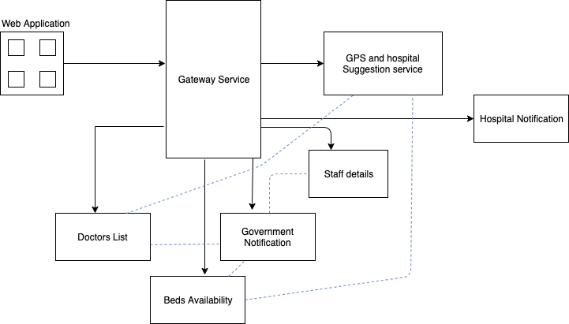
Plan for implementation phase
Architecture

Slide 9
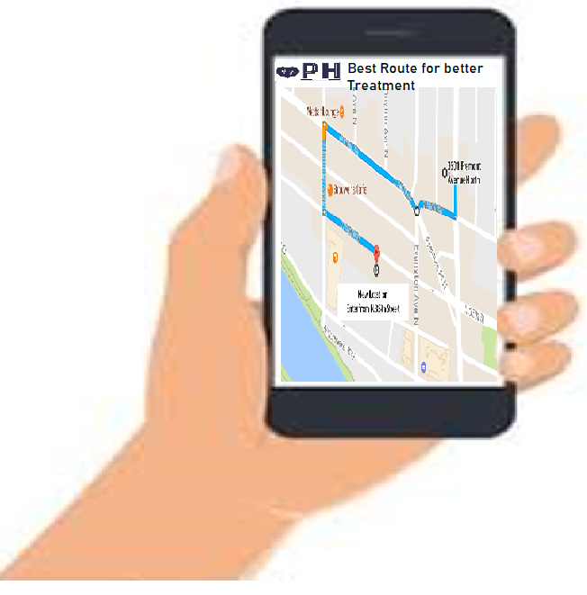
WORKFLOW

Slide 10
Thank you

